Slide 1
Data Acquisition from Remote Source and generating Visualization

Slide 2
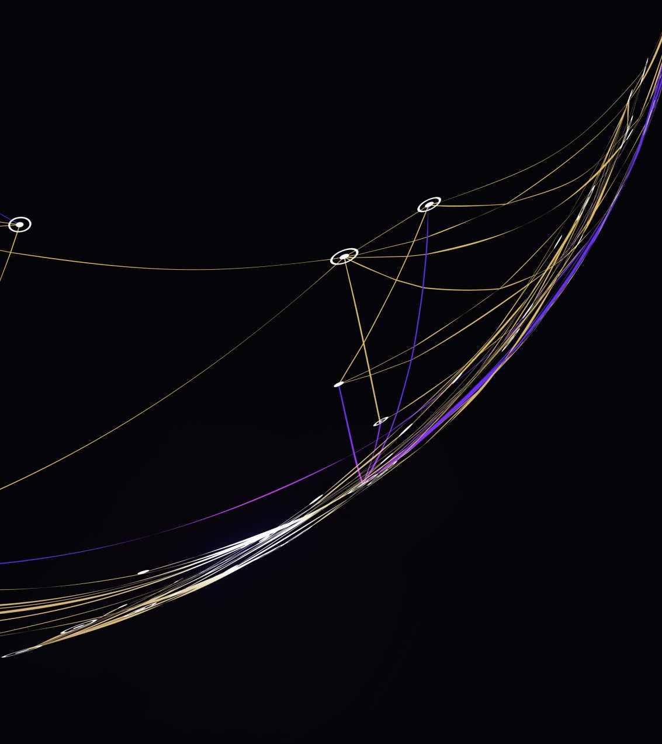
Group 7
Mahinthan Kugendiran - Developer
Syed Numan Ahmed – Data Analyst
Digvijay Singh – Business Analyst
Harishma vulli – Business Analyst
Mohammad Mustafa Khan – Project Manager

Slide 3
Introduction
Project executed by use of Java script, and python.
It includes the possession of data source located in remote.
Acquired data is then stored in cloud database

Slide 4
Project Summary
Study illustrates the data acquisition technique.
It includes the use of different languages and databases.

Slide 5

Technology used
Python 3
HTML 5
CSS
JQuery
JavaScript
Flask Framework
MongoDB
Heroku

Slide 6
Acquisition of data source
Remote source (URL) used for location of data.
Data set identified for understanding of type of data.
Python code is used for data acquisition.
URL of website is indicated in the code for reading the data.

Slide 7
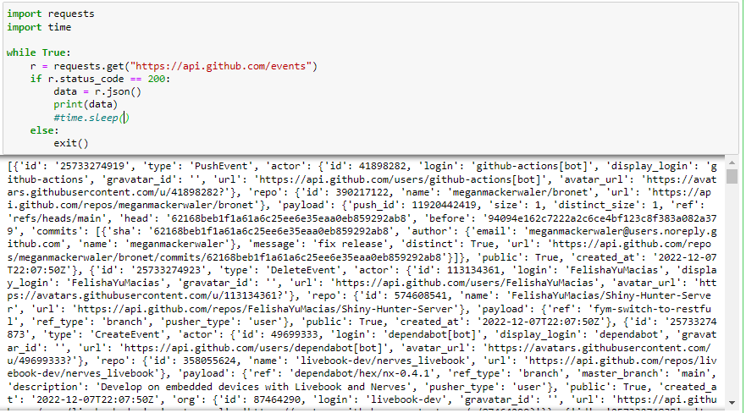
Remote URL
Python code for data acquisition and serialization into JSON
https://api.github.com/events
Above url is used to acquire data from the remote server using python
url contains the data regarding github commit events
Data can be acquired and serialized to json successfully.

Slide 8
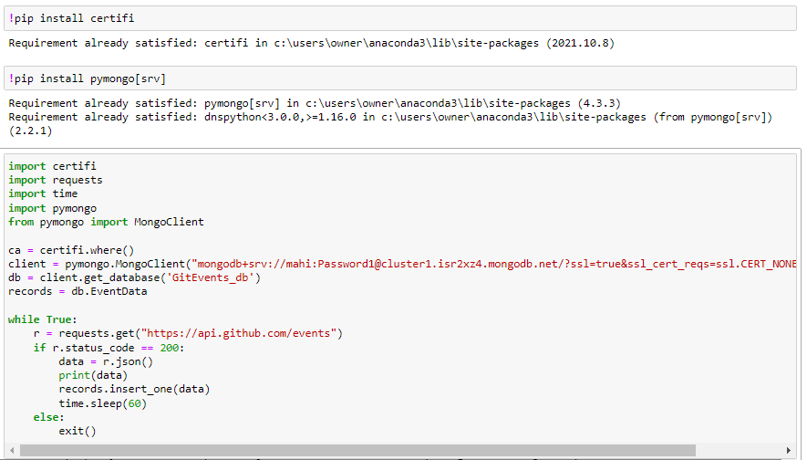
Storing data to cloud database
Python code for data acquisition and inserting into MongoDB
MongoDb is used to store acquired data in the cloud using python.
Due to some latest updates related to the MongoDb, that particular data cannot be inserted successfully.

Slide 9
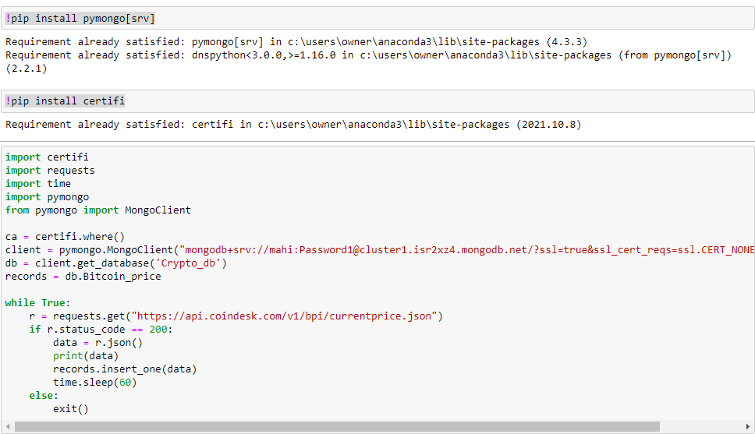
Use compatible dataset to store data in MongoDb
Python code for data acquisition and inserting into MongoDB
url: https://api.coindesk.com/v1/bpi/currentprice.json
The data can be acquired and inserted successfully to the MongoDb.

Slide 10
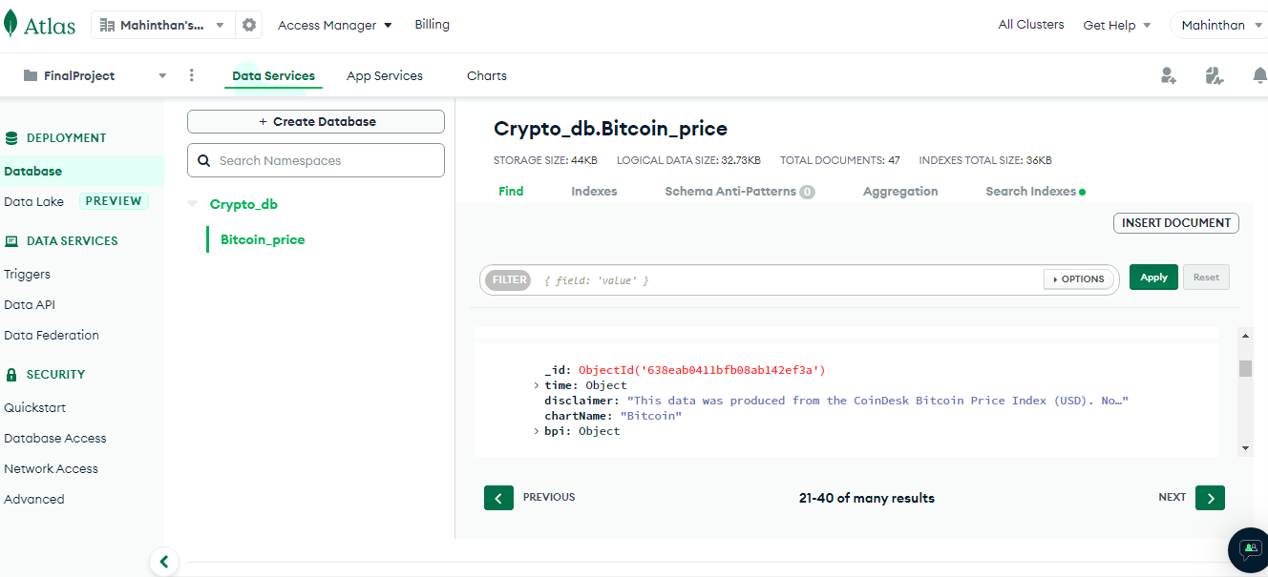
Acquired data stored in MongoDB

Slide 11
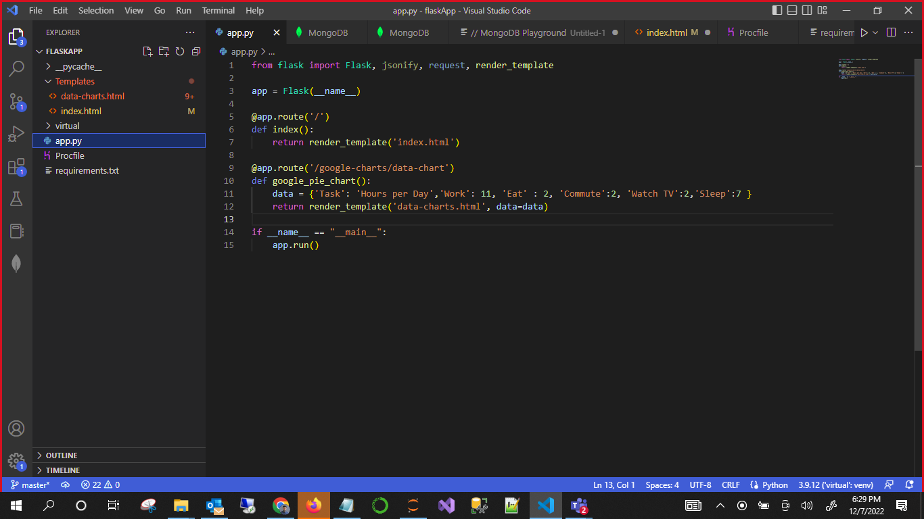
Code for Flask web application
Code for app.py file

Slide 12
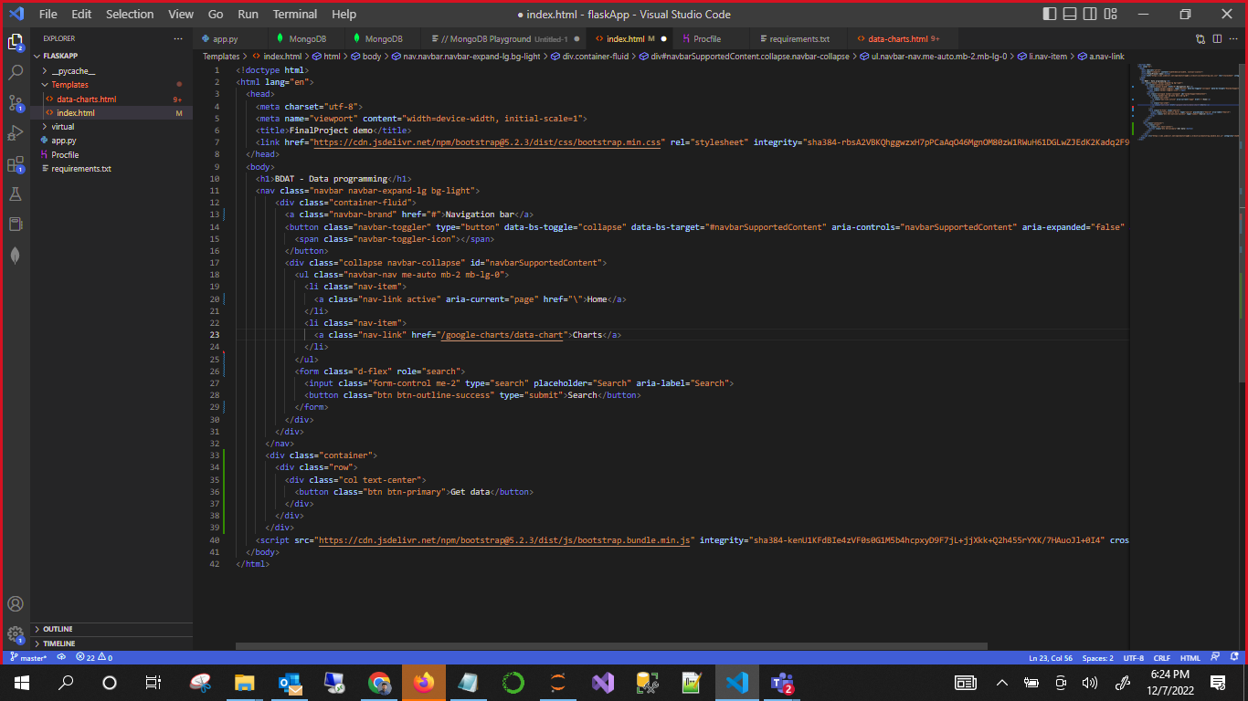
Code for Flask web application
Code for index.html file

Slide 13
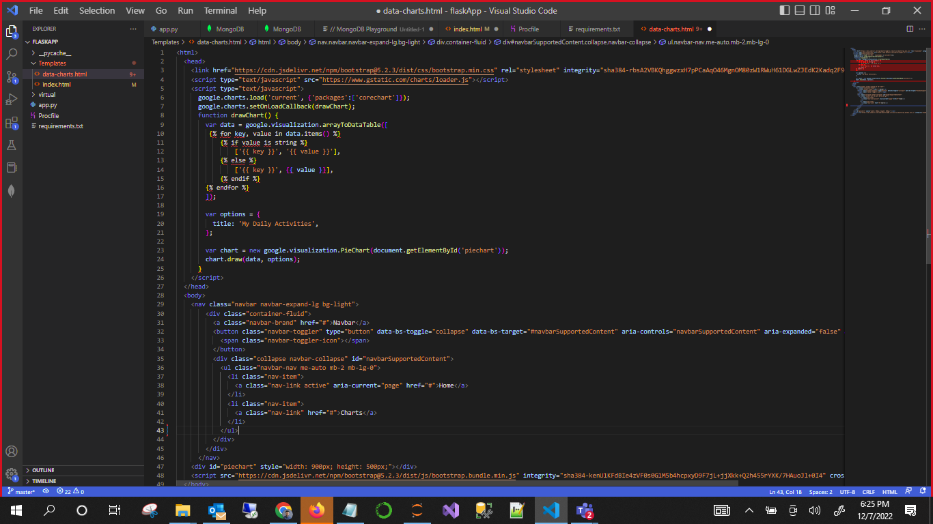
Code for Flask web application
Code for data-charts.html file

Slide 14
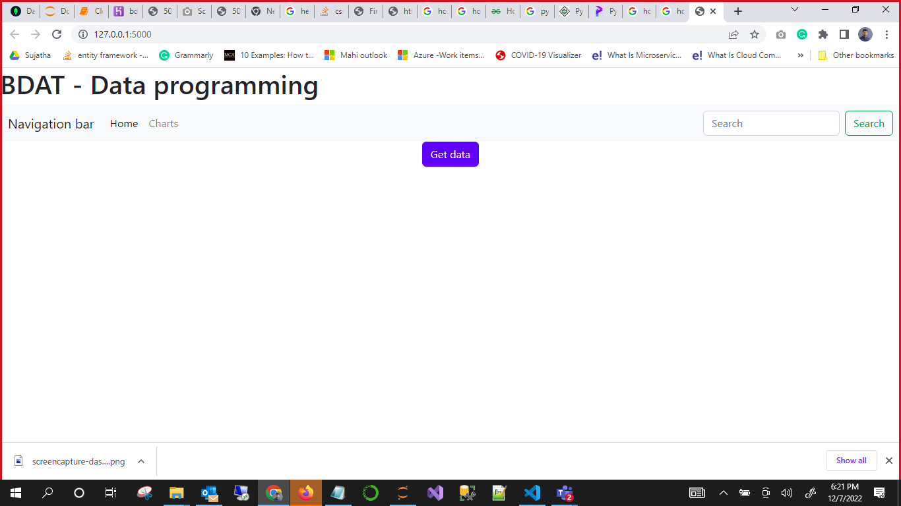
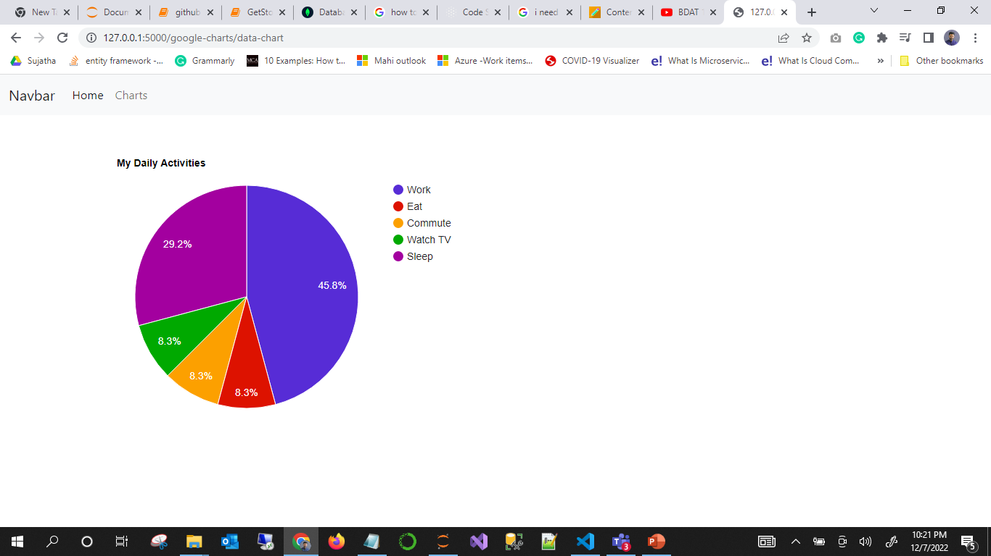
Planned User interfaces for flask web app
Home page and charts page
Clicking on get data button should retrieve the data from cloud storage
Clicking on Charts tab should navigate the user to show the data visualization

Slide 15
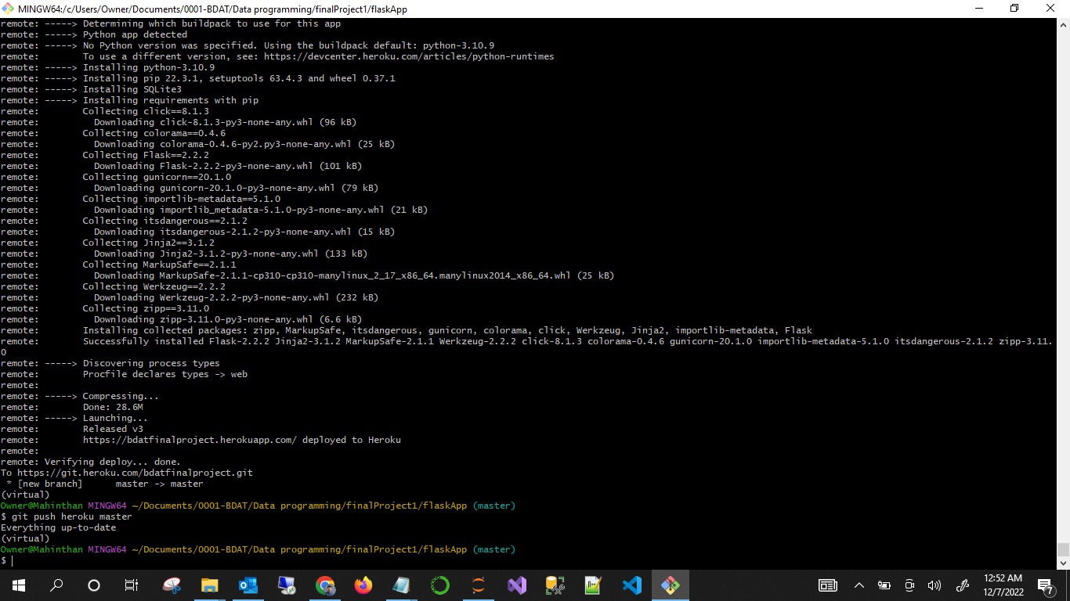
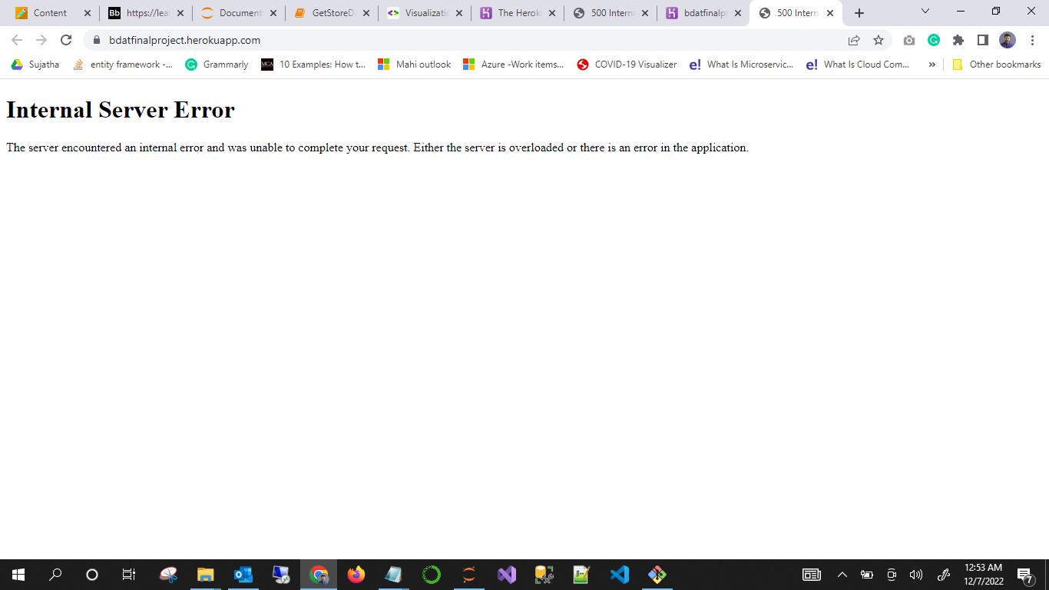
Deployment through Git Bash and Heroku PaaS
Deployment successfully done through git bash. But the app cannot be executed in Heroku server.

Slide 16
Challenge management steps
Team decided to pick different approach to analysis by the following steps.
Picking up a different dataset from www.Kaggle.com in CSV format
Import it into SQL Server Management Studio for data cleaning and analysis.
Using Power BI Report Builder to generate visualizations.
Picked dataset reference: https://www.kaggle.com/datasets/sudalairajkumar/novel-corona-virus-2019-dataset

Slide 17
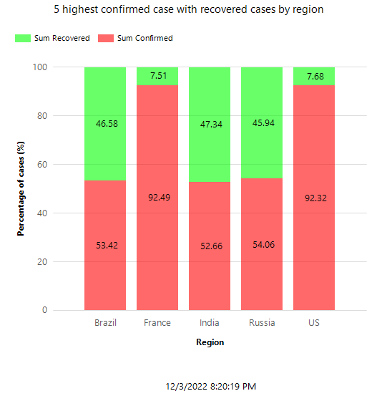
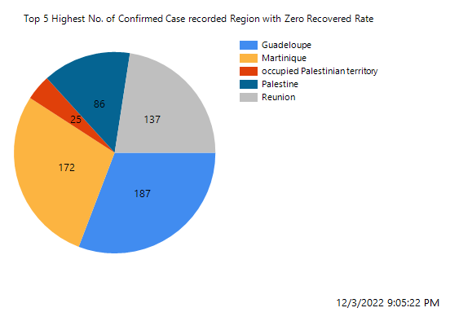
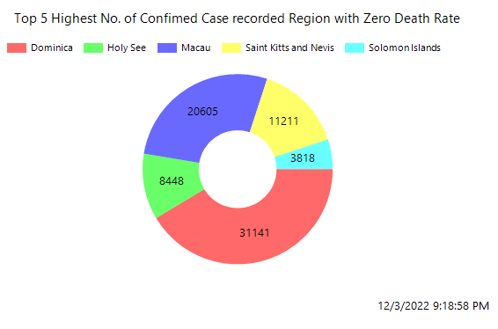
Data visualization

Slide 18
Challenges
Cannot run flask web app from heroku even after successful deployment. It raises internal server error
Cannot connect to MongoDB from flask wep app due to some environment variable in-compatible issue with local machine.
Deployment to a server makes an app to available everyone over the internet outside the developer’s local machine. But the task was hard to be achieved through Heroku PaaS.
Heroku is a platform as a service (PaaS) that enables developers to build, run, and operate applications entirely in the cloud

Slide 19
Conclusion
Data source is acquired from remote source.
Acquired data is store in cloud database.
Challenges:
Cannot run the flask web app from Heroku even after the successful deployment. It raises an internal server error
Cannot connect to MongoDB from the flask web app.

Slide 20
Thank You

